Slide 1
Information Processing Techniques
Week 05

Slide 2
Distributed Systems
Virtually all large computer-based systems are now distributed systems.
Information processing is distributed over several computers rather than confined to a single machine.
Different distributed systems architectures
client-server
peer-to-peer
parallel/cluster/grid computing
distributed object architectures -CORBA; .NET; J2EE
service-oriented architectures
Notes:
Cluster = homegenous (same hardware + OS)
Grid = Hetrogenous
Cluster = same location
Grid = Can be on different locations (Lan/Man/Wan)
A grid can make use of spare computing power on a desktop computer while the machines in a cluster are dedicated to work as a single unit and nothing else.
Remote Method Invocation (RMI)

Slide 3
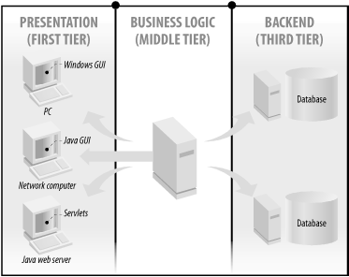
Distributed Object Architectures

Slide 4
Client-server architecture
Distributed system model where data and processing is distributed across a range of components
Set of servers which provide specific services such as printing, data management, etc.
Set of clients which call on these services
Network which allows clients to access servers
Clients know of servers but servers need not know of clients

Slide 5
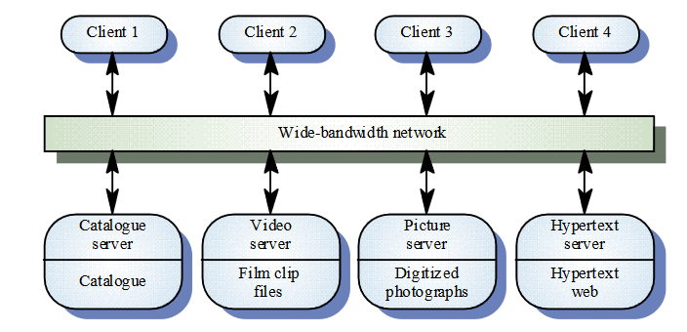
Example: Film and picture library

Slide 6
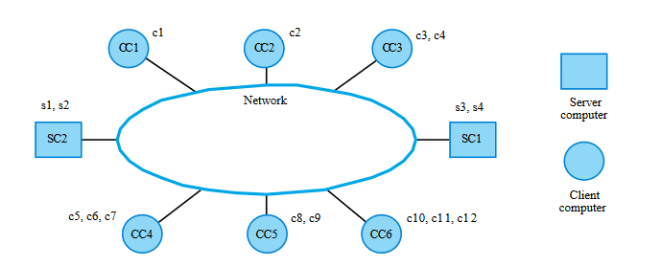
Computers in a C/S network

Slide 7
Client-server characteristics
Advantages
Distribution of data is straightforward
Makes effective use of networked systems
May require cheaper hardware
Easy to add new servers or upgrade existing servers
Disadvantages
No shared data model so sub-systems use different data organization-data interchange may be inefficient
Redundant management in each server
No central register of names and services -it may be hard to find out what servers and services are available

Slide 8
Middleware
Software that manages and supports the different components of a distributed system. In essence, it sits in the middle of the system.
Middleware can be off-the-shelf rather than specially written software
Examples
Transaction processing monitors;
Data converters;
Communication controllers.

Slide 9
Layered application architecture
Presentation layer
Concerned with presenting the results of a computation to system users and with collecting user inputs
Application processing layer
Concerned with providing application specific functionality e.g., in a banking system, banking functions such as open account, close account, etc.
Data management layer
Concerned with managing the system databases

Slide 10
Tiering
A two-tier architecture is one where a client talks directly to a server, with no intervening server
This type of architecture is typically used in small environments with less than 50 users
A three-tier architecture introduces another server (or an "agent") between the client and the server
The role of the middle-tier agent is many-fold - it can provide translation services as in adapting a legacy application on a mainframe to a client/server environnent
A plethora of software technologies have evolved to fill the middle tier - middleware

Slide 11
Thin and fat clients
Thin-client model
all of the application processing and data management is carried out on the server
client is simply responsible for running the presentation software
Fat-client model
the server is only responsible for data management.
software on the client implements the application logic and the interactions with the system user
Notes:
Chromium OS

Slide 12
Scaling
Environment is typically heterogeneous and multi-vendor
Client-server systems can be scaled horizontally or vertically
Horizontal scaling means adding or removing client workstations with only a slight performance impact. (Adding more machines)
Vertical scaling means migrating to a larger and faster server machine or multi servers. (adding hardware resources to the same machines)
The front-end task and back-end task have fundamentally different requirements for computing resources
servers typically expensive, fast, multi-processor systems, with large storage capacity
clients less expensive

Slide 13
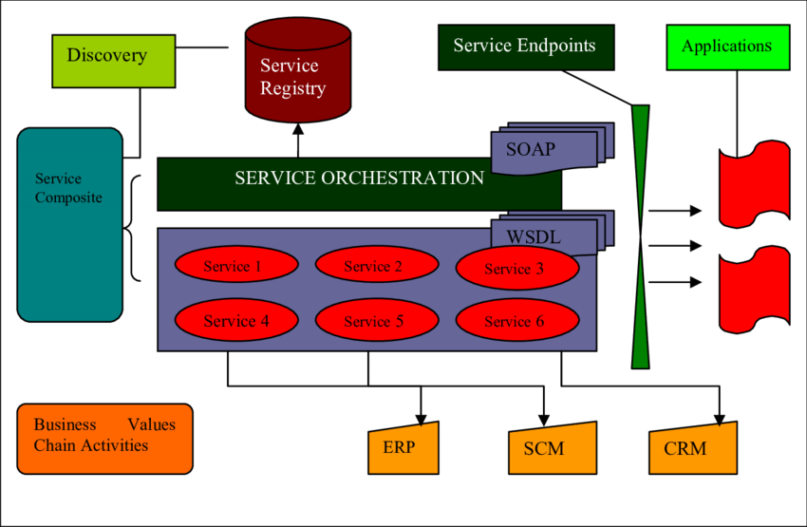
Service Oriented Architecture

Slide 14
Distributed Object Computing
Building scalable solutions require applying the appropriate level of computing power to different parts of the application.
Distributed object computing extends an object-oriented programming system by allowing objects to coexist across a heterogeneous network and interact as if they resided on the same machine.
Distributed objet systems have several problems.

Slide 15
OOP and Network Latency
The style of object-oriented programming directly conflicts with the performance of distributed system.
Object oriented classes are fine-grained, with property and field accessors.
Object interactions lead to many round trips across the network. Network latency causes severe performance degradation. You want to minimize the number of interactions between client and server.

